Slide 1
X-RAY DETECTION USING CNN
PRESENTED BY:KARTHIKEYAN S
REGISTER NO:711721243043
DEPARTMENT:ARTIFICIAL INTELLIGENCE AND DATA SCIENCE
3/21/2024 Annual Review

Slide 2
PROJECT TITLE
X-RAY DETECTION USING CNN
3/21/2024 Annual Review

Slide 3


AGENDA
1.Problem Statement
2.Project Overview
3.End users
4.Our Solution and its value Proposition
5.Modelling Approach
6.Result and Evaluation
7.Conclusion
3/21/2024 Annual Review

Slide 4

PROBLEM STATEMENT
The task at hand is to develop a Convolutional Neural Network (CNN)-based system capable of accurately detecting and classifying objects or anomalies within X-ray images.
This involves challenges such as object detection and localization of various anomalies, classification of detected objects, handling varied image conditions including resolution, noise, and lighting variations, efficient data collection and annotation, ensuring interpretability and trustworthiness of the model's decisions, and addressing regulatory and ethical considerations for real-world deployment
3/21/2024 Annual Review

Slide 5

PROJECT OVERVIEW
The project focuses on leveraging Convolutional Neural Networks (CNNs) to develop a robust system for X-ray detection, aiming to accurately identify and classify objects or anomalies within X-ray images.
Key components include meticulous data collection and preprocessing to ensure dataset diversity and quality. Designing tailored CNN architectures, training, and optimizing them with advanced techniques to improve model performance and generalization capabilities are crucial aspects.
.
Object detection and localization algorithms, along with anomaly classification techniques, will be implemented to precisely identify and categorize anomalies within X-ray images. Evaluation metrics will be employed to rigorously assess the model's performance on real-world datasets, ensuring robustness and reliability
3/21/2024 Annual Review

Slide 6

WHO ARE THE END USERS?
The end users for X-ray detection using Convolutional Neural Networks (CNNs) can vary depending on the specific application domain. Here are some potential end users across different sectors:
Medical Professionals
Security Personnel
Industrial Inspectors
Research Institutions
Emergency Responders
Government Agencies
Private Sector Companies
Educational Institutions
3/21/2024 Annual Review

Slide 7

OUR SOLUTION AND ITS VALUE PROPOSITION
Our solution for X-ray detection using Convolutional Neural Networks (CNNs) represents a cutting-edge approach poised to revolutionize the field of X-ray image analysis.
Its advanced algorithms and robust training techniques ensure reliable performance across diverse datasets and imaging conditions, delivering consistent results even in challenging environments.
Moreover, we prioritize the interpretability and explainability of our solution, providing users with insights into the decision-making process of the model through intuitive visualizations.
With scalability, seamless integration,and ethical guidelines, our solution offers a comprehensive and cost-effective means to enhance X-ray image analysis, yielding significant improvements in accuracy, efficiency, and operational effectiveness for our users.
3/21/2024 Annual Review

Slide 8

THE WOW IN OUR SOLUTION
Breakthrough Accuracy
Real-time Efficiency
Adaptability to Varied Conditions
Intuitive Interpretability
Seamless Integration and Scalability
Ethical and Regulatory Compliance
Transformative Cost-effectiveness
3/21/2024 Annual Review

Slide 9
MODELLING
Data Preparation:
1.Import the X-ray image dataset, ensuring it is properly formatted and annotated with ground truth labels.
2.Divide the dataset into training, validation, and test sets to facilitate model evaluation.
3.Perform preprocessing steps such as resizing, normalization, and augmentation to enhance dataset quality and diversity.
Model Architecture Design:
1.Select a suitable CNN architecture tailored for X-ray image analysis, such as VGG, ResNet, or DenseNet.
2.Customize the chosen architecture to accommodate the specific characteristics of X-ray images, such as their high contrast and grayscale nature.
3.Incorporate additional layers or modifications as needed to optimize the model for object detection and classification tasks.
Training and Optimization:
1.Initialize the CNN model with appropriate weights or pre-trained models if available, leveraging transfer learning techniques to expedite training.
2.Define suitable loss functions, such as categorical cross-entropy or binary cross-entropy, depending on the classification task.
3.Employ optimization algorithms like Stochastic Gradient Descent (SGD), Adam, or RMSprop to minimize the loss function and update model parameters iteratively.
4.Tune hyperparameters including learning rate, batch size, and regularization techniques to improve model convergence and generalization.
3/21/2024 Annual Review

Slide 10
Object Detection and Localization:
  Implement algorithms for object detection and localization within the CNN architecture, such as Region-based CNNs (R-CNN), Single Shot Detectors (SSD), or You Only Look Once (YOLO).
  Fine-tune the detection and localization layers to accurately localize objects or anomalies within X-ray images while minimizing false positives.
Anomaly Classification:
  Incorporate classification layers into the CNN architecture to classify detected objects or anomalies into relevant categories.
  Utilize activation functions like softmax for multi-class classification or sigmoid for binary classification, depending on the number of classes.
Model Evaluation:
  Evaluate the trained CNN model's performance using appropriate evaluation metrics such as accuracy, precision, recall, F1-score, and area under the Receiver Operating Characteristic (ROC) curve.
  Validate the model on the held-out validation set and assess its generalization capabilities on unseen test data.
  Fine-tune model parameters or architecture based on validation performance to optimize model performance.
Interpretability and Explainability:
  Implement techniques for interpreting and explaining the model's decisions, such as generating heatmaps, saliency maps, or attention mechanisms to highlight regions of interest within X-ray images.
Deployment and Integration:
  Deploy the trained CNN model into practical applications for real-world deployment, integrating it with existing X-ray imaging systems or workflows.
  Develop user-friendly interfaces or APIs to facilitate seamless integration and interaction with the CNN-based X-ray detection system.

Slide 11
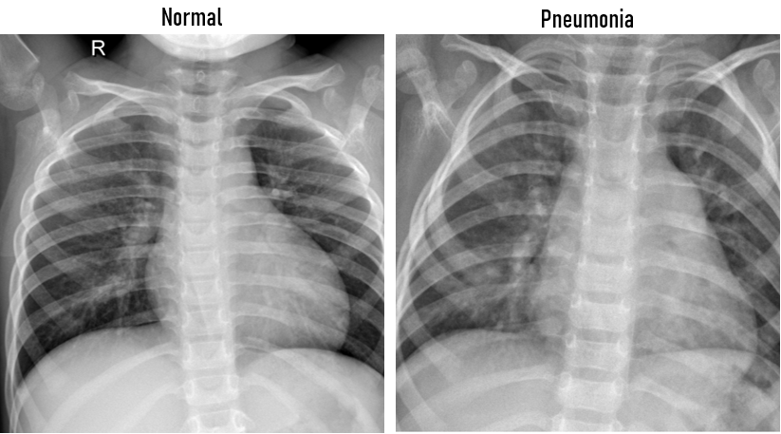
RESULTS
Demo Link
3/21/2024 Annual Review

